Slide 1
This resource addresses the crisis of Missing and Murdered Indigenous Women, Girls, and Two-Spirit people (MMIWG2S+). Some content may be emotionally difficult. Please review materials in advance, move through them at your own pace, and take care of yourself as you engage with this learning.

Slide 2
01
Supports

Slide 3
Supports
24/7 Support Line
A national, independent support line is available for emotional assistance:
1-844-413-6649
Elizabeth Fry Society
https://www.efryokanagan.com/
Phone: (250) 763-4613
Email: info@efryokanagan.com
Hope for Wellness Helpline
Immediate crisis intervention and counselling (phone and online chat):
https://www.hopeforwellness.ca/
Aftercare Services
Provided by Indigenous Services Canada, offering mental health counselling, community-based supports, and cultural services:
https://www.rcaanc-cirnac.gc.ca/eng/1541187352297/1541187392851
For Community Members
WFN Health & Wellness Building
https://www.wfn.ca/health-wellness.htm
(250) 768-0227

Slide 4
Supports
Advocacy and Safety
Native Women's Association of Canada (NWAC)
Direct support programs and national advocacy for MMIWG2S+ families and survivors:
https://nwac.ca/
Key Initiatives
National Action Plan to End Violence Against Indigenous Women, Girls, and 2SLGBTQQIA+ People
A comprehensive, collaborative plan developed with families, survivors, and Indigenous partners:
https://MMIWG2Splus-nationalactionplan.ca/
Final Report of the National Inquiry into Missing and Murdered Indigenous Women and Girls
Includes findings and the Calls for Justice:
https://www.mmiwg-ffada.ca/final-report/

Slide 5
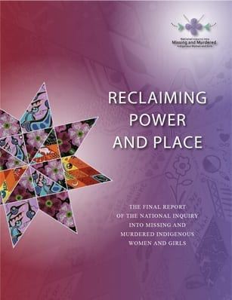
For Teachers:
Before you begin exploring this topic with your learners, please familiarize yourself with the Final Report on MMIWG2S+

Slide 6
Red Dress Day
-May 5-
We remember and honour missing and murdered Indigenous women, girls, and Two-Spirit people.
A red dress is used as a symbol to represent those who are missing.

Slide 7


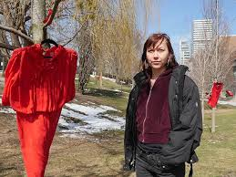
What does the Red Dress mean?
It is a symbol of remembrance, visibility, and respect. Artist Jaime Black created the REDress Project to help people see and understand this issue.

Slide 8
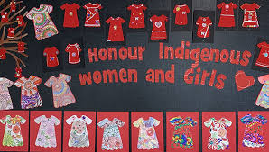
Why is this day important?
For too long:
Red Dress Day helps us:
these cases were not always taken seriously
families did not always get answers
many people did not know this was happening
learn
remember
pay attention
care for one another

Slide 9
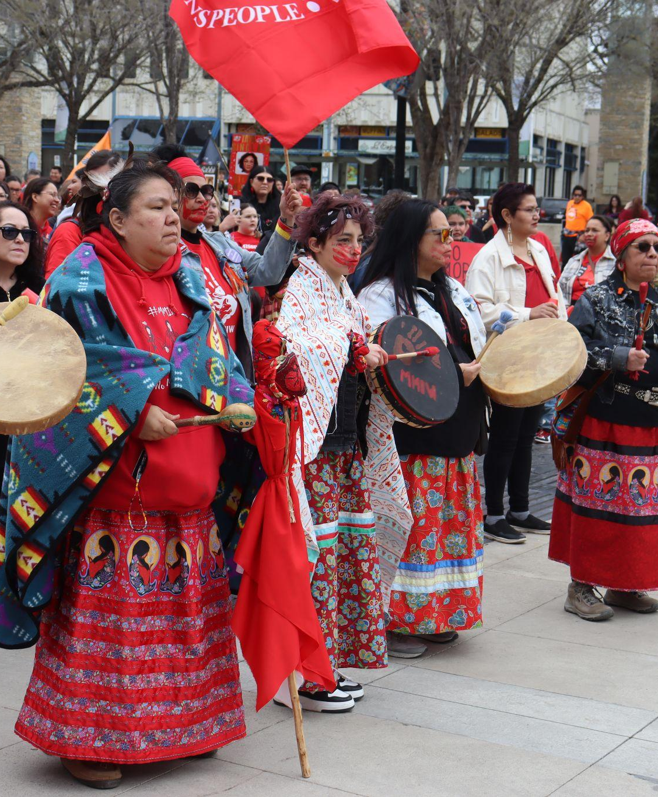
How can we approach this learning?
As we learn, we can:
listen with care and respect
think about what we are noticing and wondering
take time if we need it
You might ask yourself:
What am I learning that I didn’t know before?
Why does this matter?
How can we show respect in our learning?

Slide 10

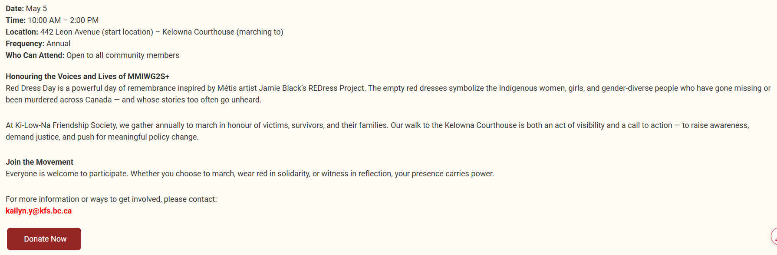
How can you get involved?

Slide 11
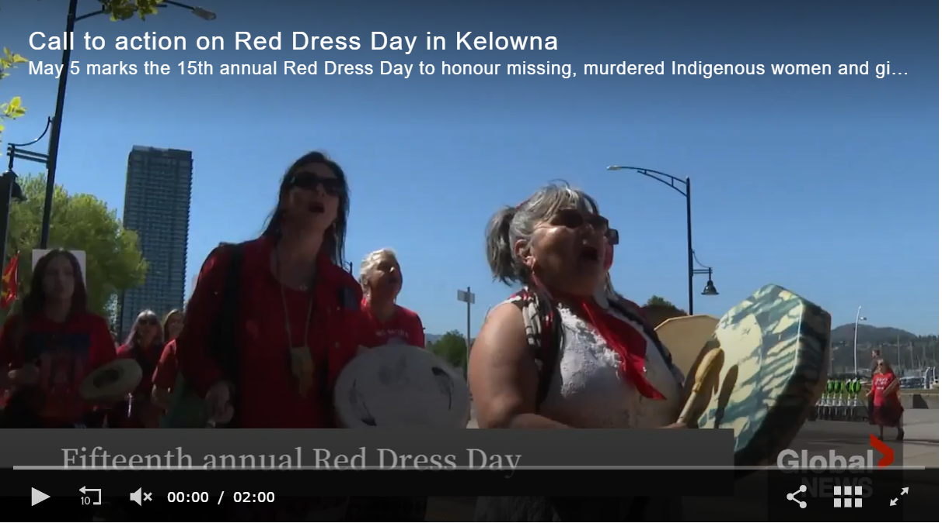

Slide 12

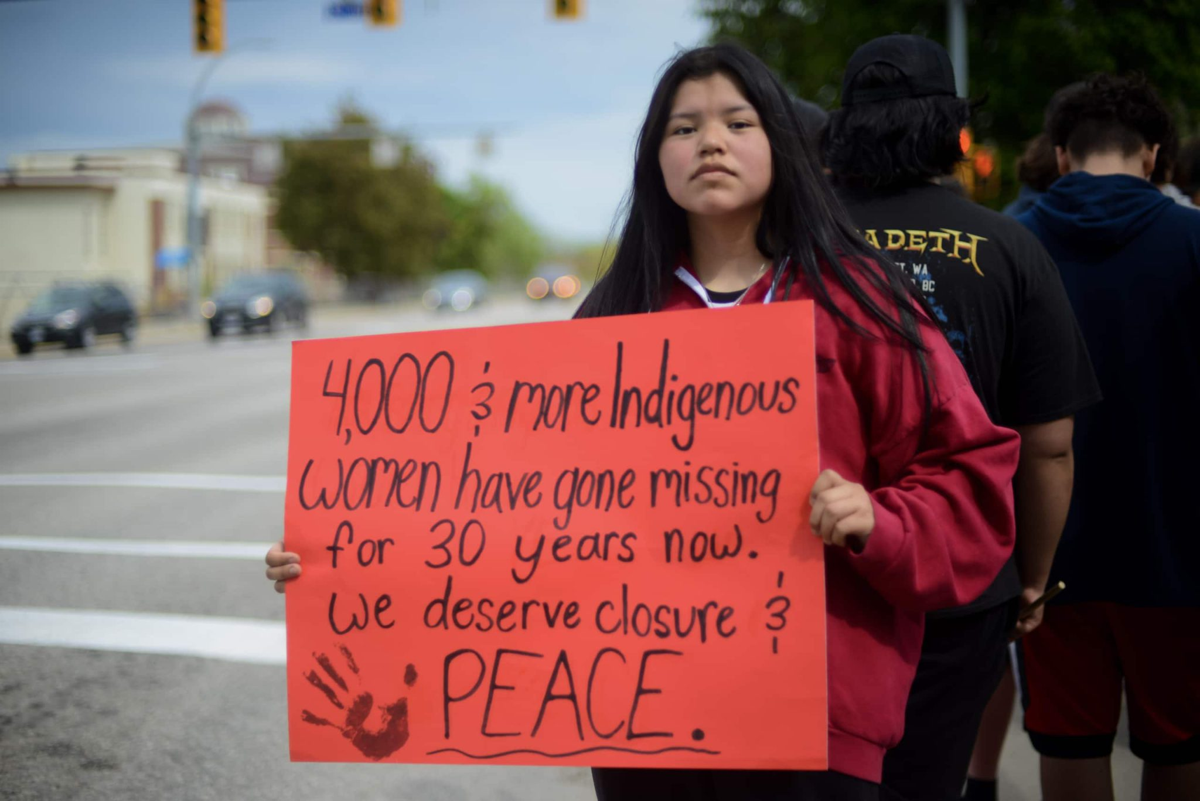
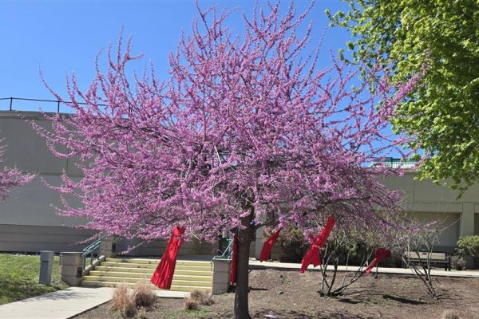
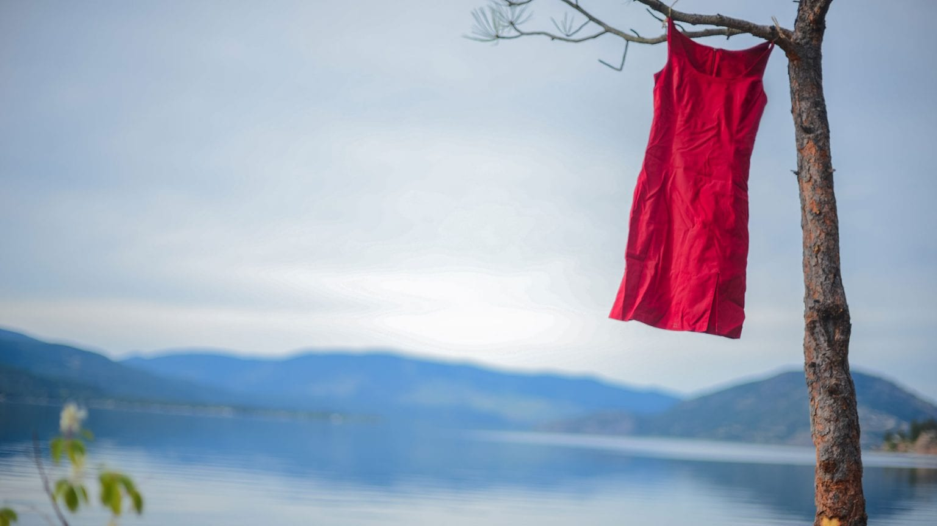
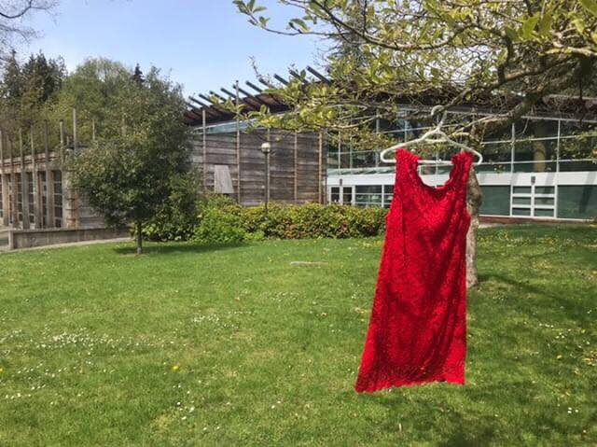
Local Connections and Initiatives
Red Dress Day: Acknowledging the Crisis, Honouring the Lives Lost - Westbank First Nation
syilx students lead Red Dress Day event with powerful calls for change - Indiginews
Red Dress Day | Okanagan College
Beyond Red Dress Day: Seven calls to action for Indigenous allies
Missing and Murdered Indigenous Women, Girls, & Two-Spirit (MMIWG2S+) Guide - Research Guides at University of British Columbia

Slide 13
Resources
01
02
03
04
05
06
Supports
Primary
Intermediate
Middle Years
Secondary
Additional Considerations & Resources

Slide 14
02
Primary

Slide 15
How do I approach this topic in the early years?
From Carolyn Roberts, a renowned educator, speaker and storyteller with a wealth of experience and expertise in Indigenous education and decolonization. She is a St’at’imc and Sto:lo woman belonging to the Thevarge family from N'quatqua Nation and the Kelly Family from the Tzeachten Nation and a member of the Squamish Nation
“As I thought through this more what I kept coming back to was acknowledging and honouring Indigenous women. The younger grades can understand and see connections to family and people in our families. I think this is the place where we can start this work. Sharing the strength of Indigenous women, how through an Indigenous perspective we honour women in our communities. If we build the foundation of knowledge and understanding of strong and brilliant Indigenous women and girls, then in grade 4 we can start to unpack MMIWG. This will help with the why, it is so important to learn about MMIWG2S+ because we have already created the foundation of why Indigenous women in our culture are so important.”
Source: https://www.carolynroberts.net/single-post/thinking-about-red-dress-day-for-elementary-students

Slide 16

K-5
Moosehide Campaign
https://education.moosehidecampaign.ca/earlyyears/
View and download our lesson plans for early year students
These lesson plans are designed for students from K-5

Slide 17
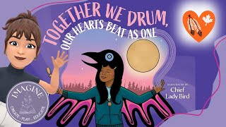
Grade 3
https://www.teachermag.ca/post/lesson-ideas-to-commemorate-red-dress-day-the-national-day-of-awareness-for-mmiwg
This story can be used to approach the subject of Murdered and Missing Indigenous Women, Girls, Two-Spirited+ (MMIWG2S+) in a sensitive manner for primary students. Teachers can choose how deeply to engage with this book. For example, it could start the conversation with young children about the hardships Indigenous women and girls face, as well as how all of us can learn to deal with painful events, racism, and what Willie Poll calls “a monster named Hate.”

Slide 18
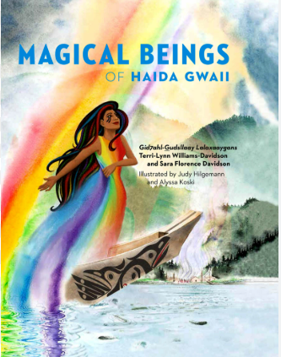
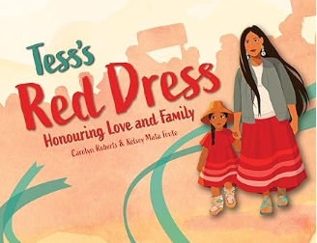
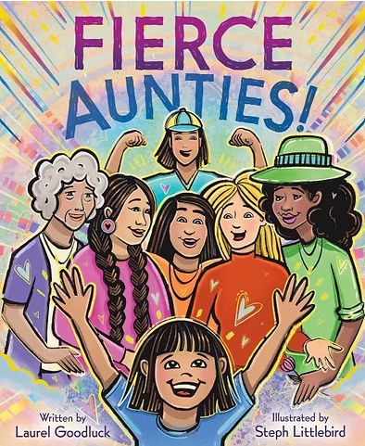
Picture Books
Fierce Aunties-A joyful and vibrant celebration of what makes aunties so special, from Indigenous author and illustrator team Laurel Goodluck and Steph Littlebird inviting all kids to connect with the fierce aunties in their lives.
This story opens an important doorway for talking with young learners about Missing and Murdered Indigenous Women and Girls, 2SLGBTQPlus(MMIWG) in ways that are thoughtful, age-appropriate, and grounded in care.
This book shares with the reader connections to Indigenous identity and Indigenous worldviews. Sharing with us the importance of how all things are related and interconnected. This is so important when we are talking about how important Indigenous women and girls are in our families and communities. There is a teacher’s guide and colouring book also available with this book.

Slide 19
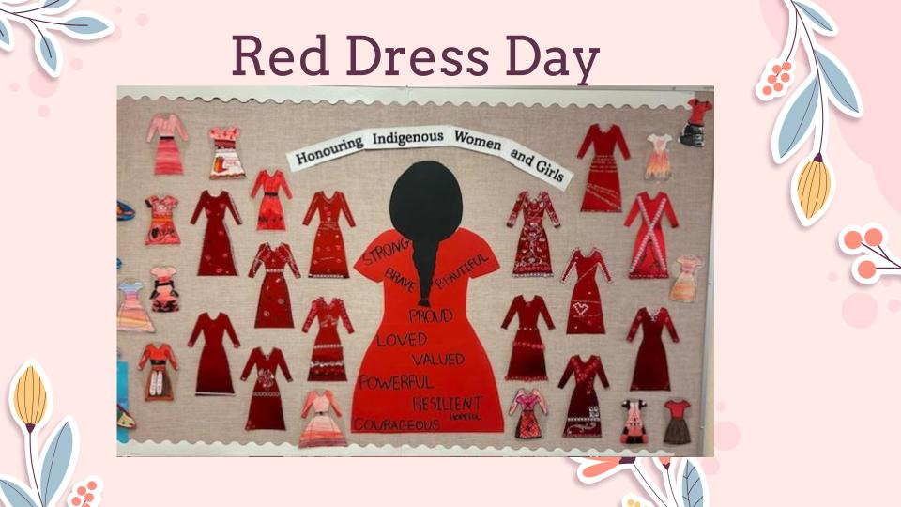
Chief Tomat Elementary
Whole school assembly

Slide 20
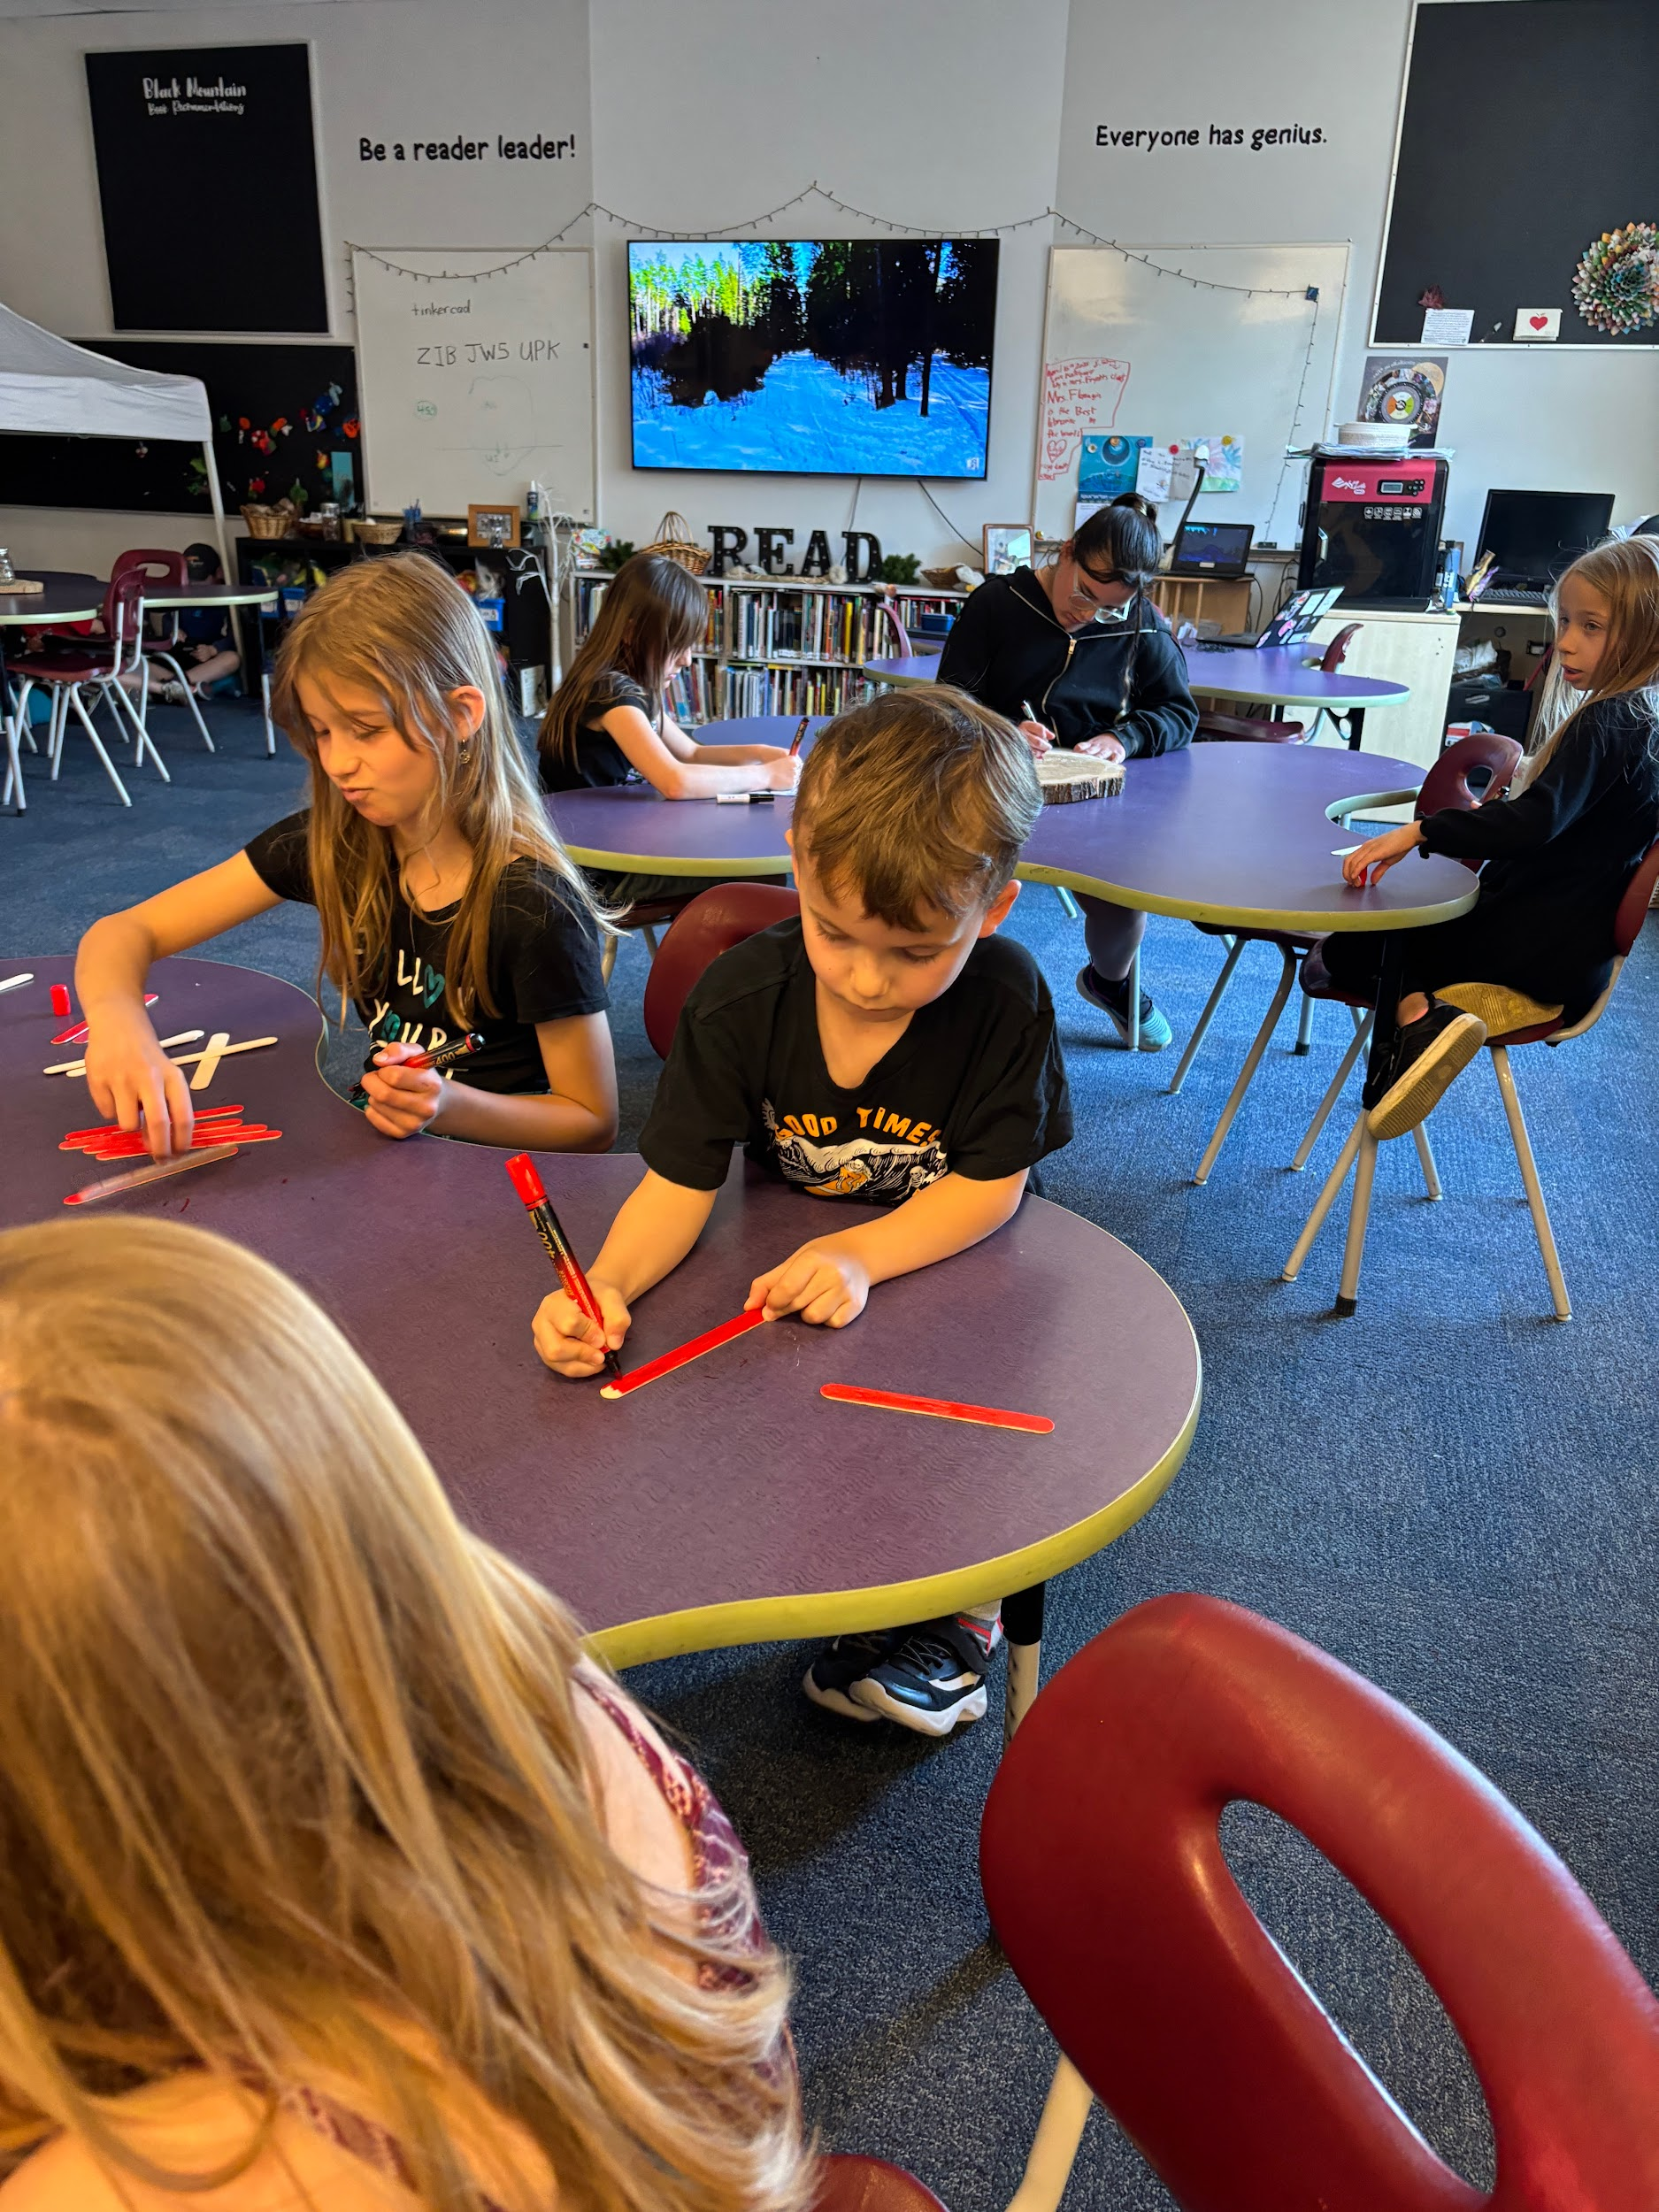
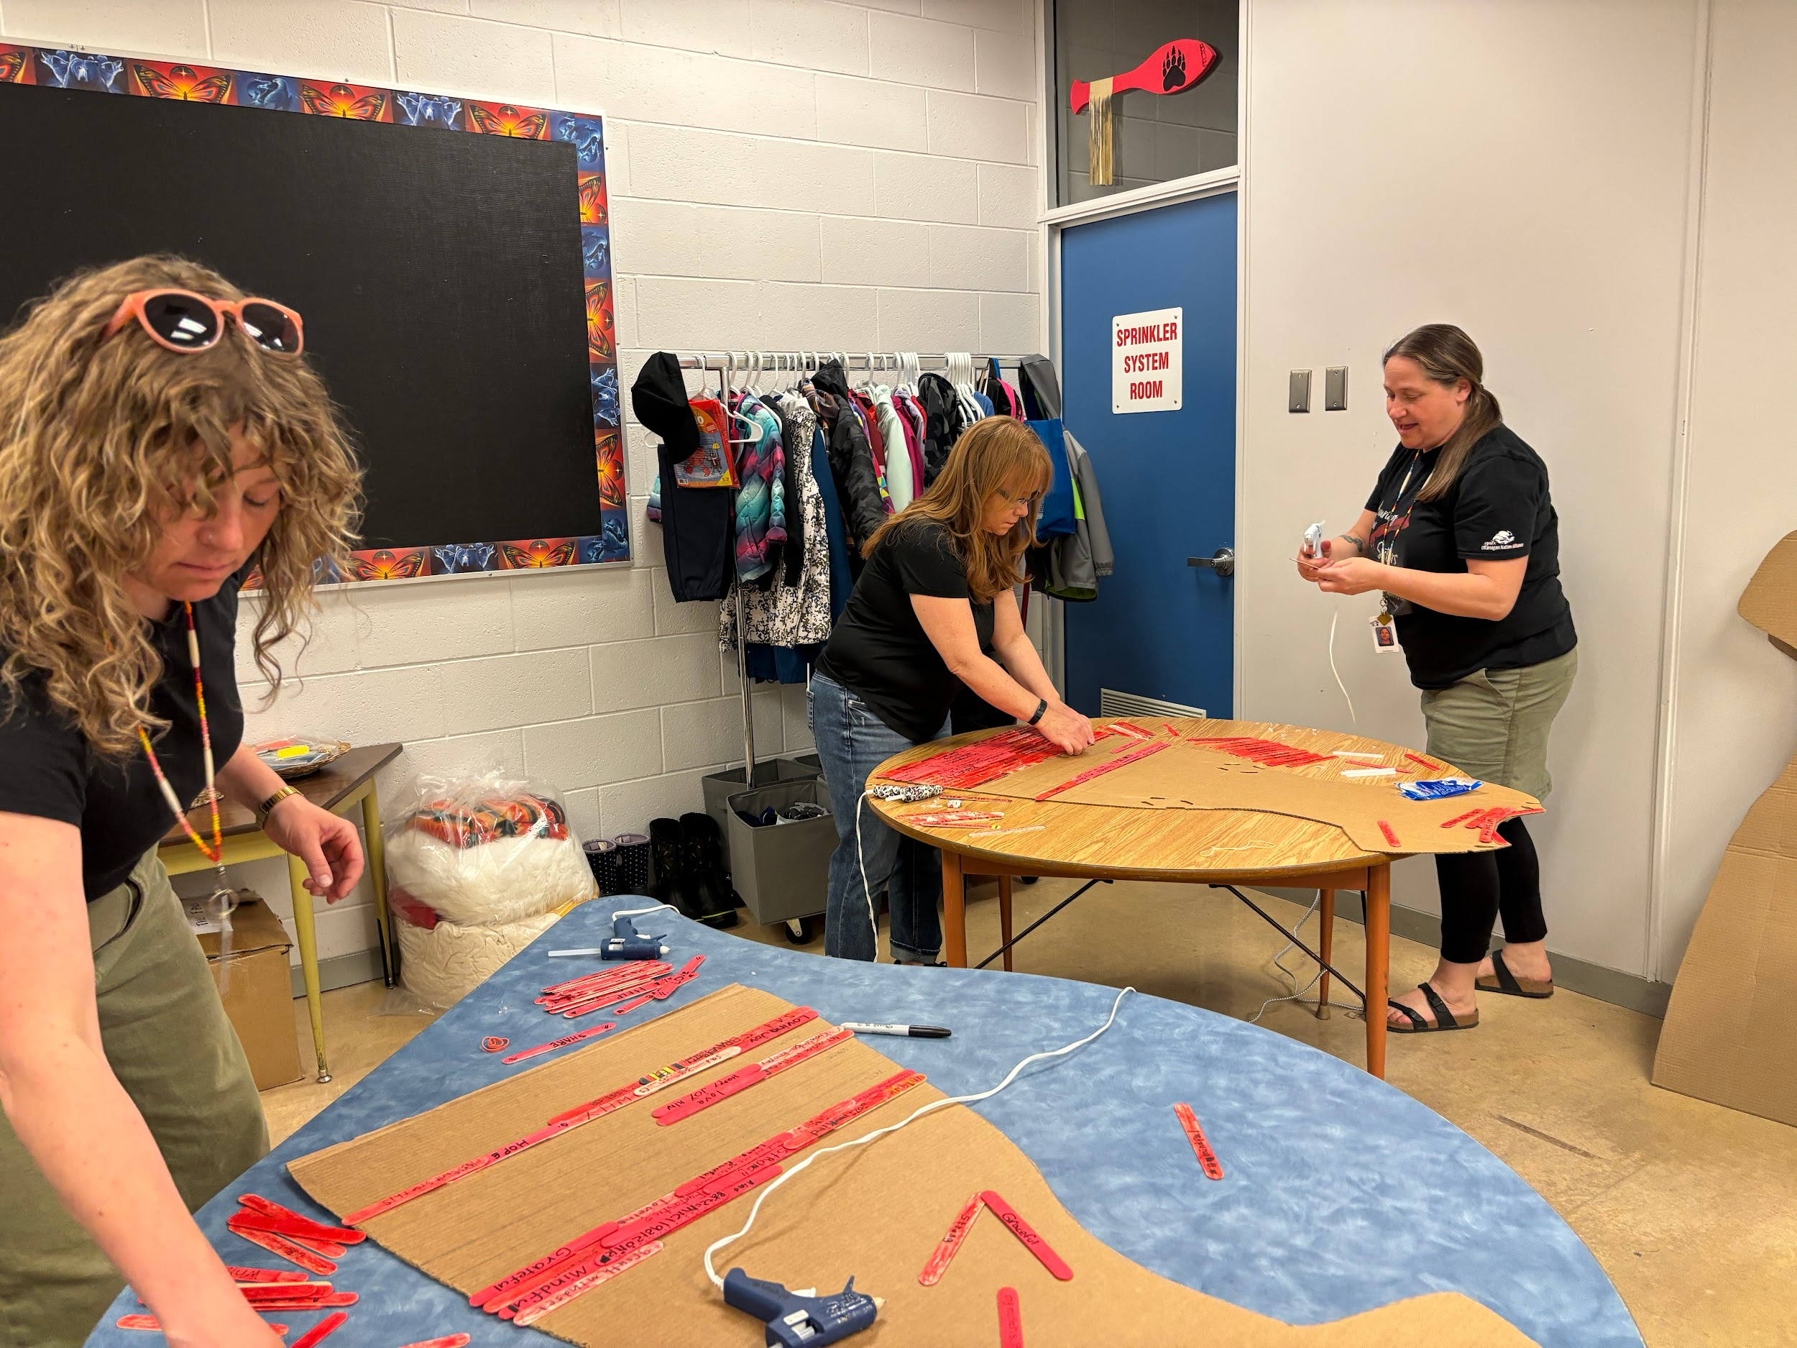
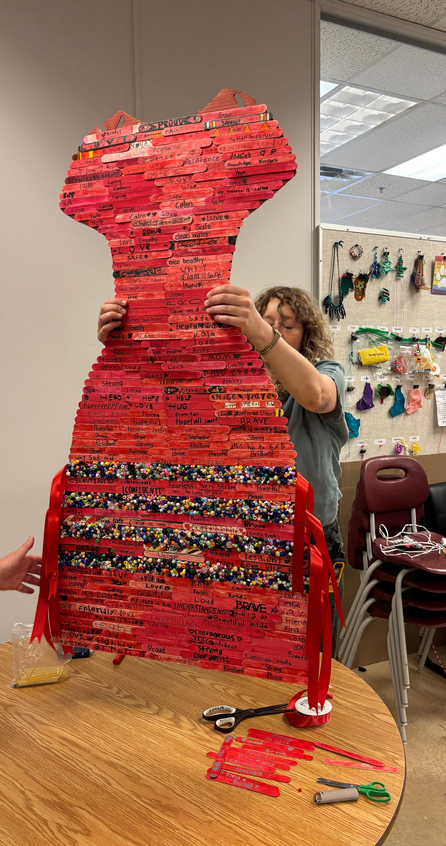
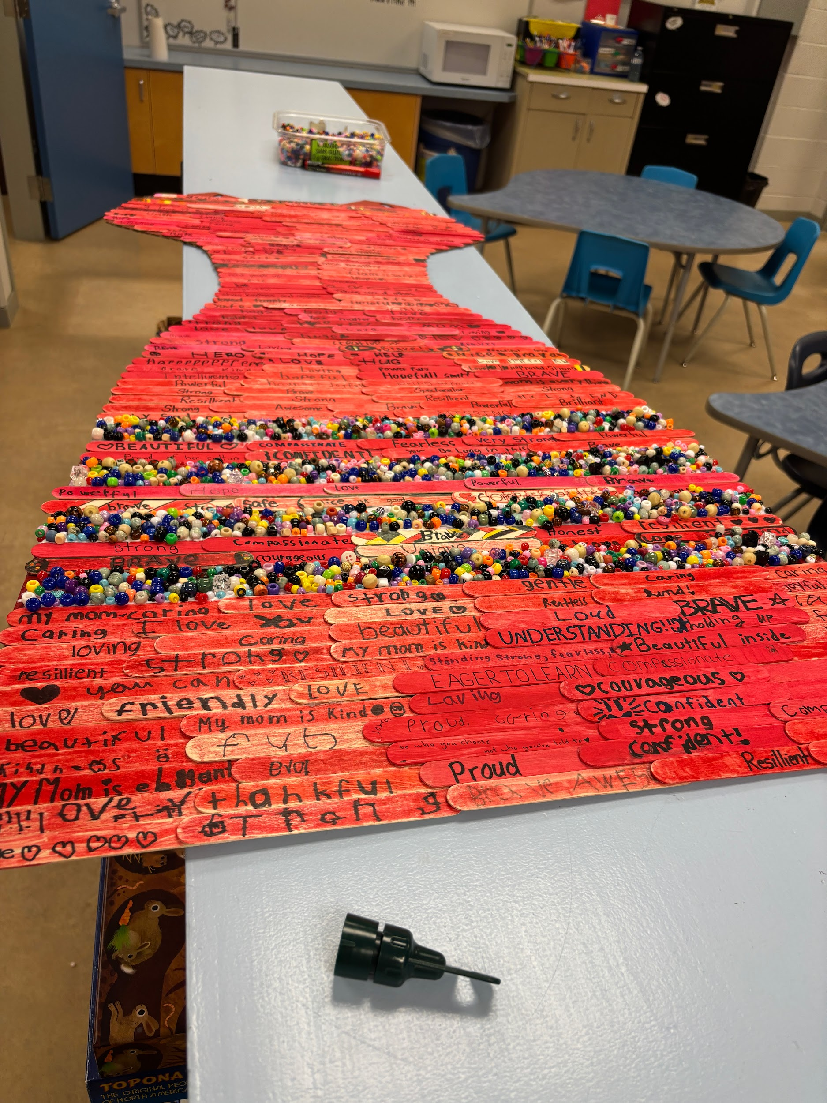
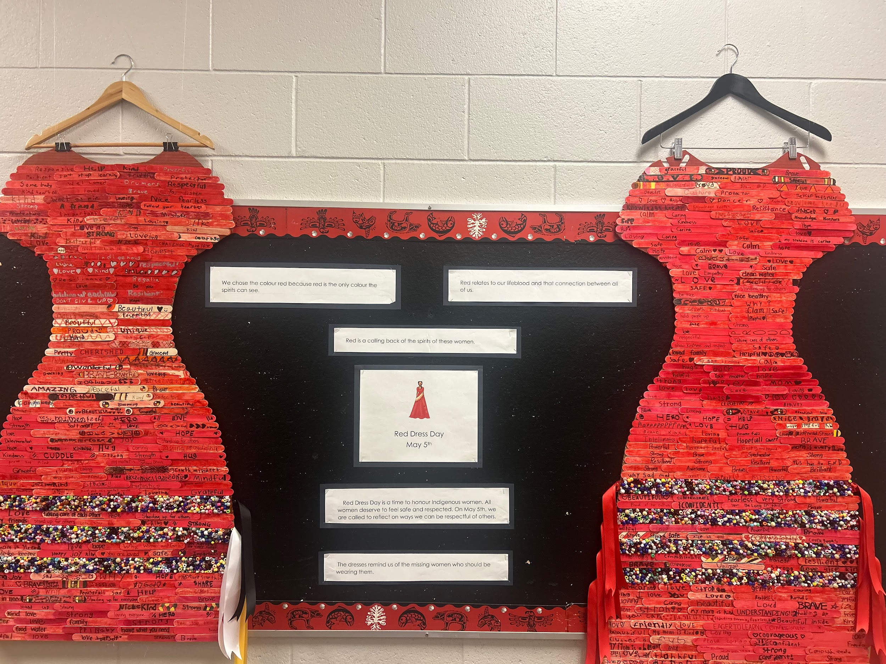
Black Mountain Elementary
At BME, we approached this day with care, respect, and the awareness that the learners we serve might not yet be ready to explore all parts of the truth of this crisis. With our youngest learners, we took guidance from Carolyn Roberts’ writings and focused on the strength, power, and resilience of Indigenous women. We used picture books that feature Indigenous women and with our older learners, we used age-appropriate mentor texts. Each child in the school then made their commitment visible by painting a piece of wood red and contributing a word of hope, honour, respect, or acknowledgement. The words of the children were transformed into two red ribbon dresses to symbolize all the MMIWG2S+. We plan to incorporate these dresses into our day again this year.

Slide 21
03
Intermediate

Slide 22
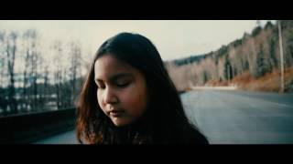
Grades 4-6
https://www.youtube-nocookie.com/embed/hG_9d260YeI
This music video, created by Indigenous youth in Kitsumkalum First Nation, shares a powerful message about Missing and Murdered Indigenous Women and Girls (MMIWG2S+). The song reflects feelings of loss, fear, and sadness, while also emphasizing connection, strength, and hope.
The title “The Highway” refers to the Highway of Tears in northern British Columbia, where many Indigenous women and girls have gone missing or been murdered. The video uses music and storytelling to raise awareness and encourage people, especially youth, to speak up and care about this issue.
Students could compile short audio messages or video that shares how people can care for and protect one another in their community.

Slide 23
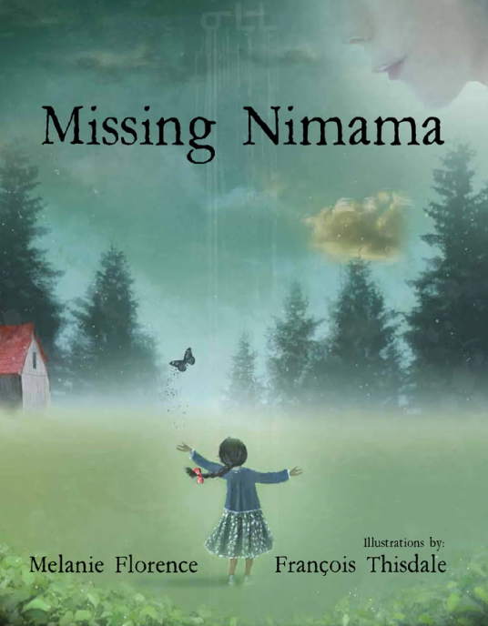
Grades 4-6
https://definingmomentscanada.ca/bryce100/educational-resources/lesson-plan-dr-bryce-advocacy/
Grade Level: Upper Elementary
Timing: Varies, suggest to spread the learning over 3-5 days
Purpose
To understand how we can be advocates for justice through an analysis of the work of Dr. Peter Henderson Bryce and explorations of the issues surrounding Missing and Murdered Indigenous Women, Girls, and Two-Spirit People (MMIWG2S+).

Slide 24
04
Middle Years

Slide 25
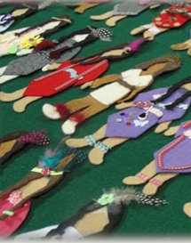
Grades 6-8
https://nwac-afac.ca/assets-knowledge-centre/Red-dress-day-TOOL-KIT.pdf
The Red Dress Day Toolkit is an educational and advocacy resource designed to raise awareness about the crisis of Missing and Murdered Indigenous Women, Girls, and 2SLGBTQIA+ people (MMIWG2S+). It provides background information, classroom-ready materials, and guidance to help individuals and educators engage respectfully and meaningfully with this issue.

Slide 26
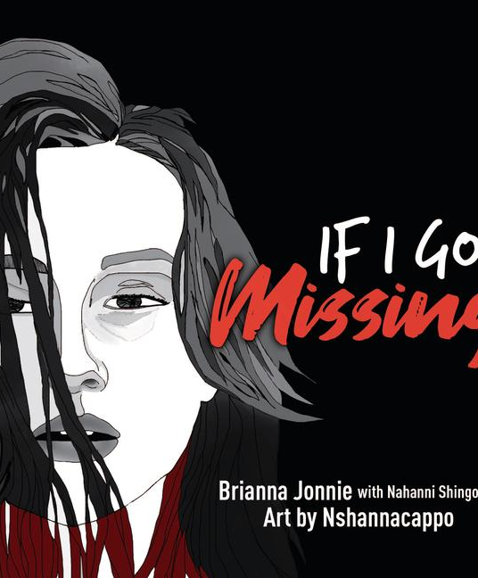
Grades 6-8
If I Go Missing is a graphic novel based on a letter written by 14 year old Brianna Jonnie to the Winnipeg Police Service. The text of If I Go Missing is by Brianna Jonnie, Ojibwe, with Nahanni Shingoose, Ojibwe and Irish, and art by Neal Nshannacappo, Nakwe (Saulteaux). This graphic novel begins with a quote from the United Nations Declaration on the Rights of Indigenous Peoples and the right of Indigenous women and children to be free from all forms of violence and discrimination. Citing statistics and information on murdered and missing Indigenous women and girls, this is an open letter to understand how missing people are treated differently especially Indigenous women and girls by society and men and boys in particular. It is also a call on police services, media and communities to exhaust all efforts to find Indigenous girls and to do this as soon as possible because it is not about the colour of one’s skin, socio-economic status, or legal guardianship but details that humanize those who go missing that matters.

Slide 27

Grade 6-8
Moosehide Campaign
https://education.moosehidecampaign.ca/middleyears/
View and download the lesson plans for middle year students. These lesson plans are designed for students from grades 6-8

Slide 28
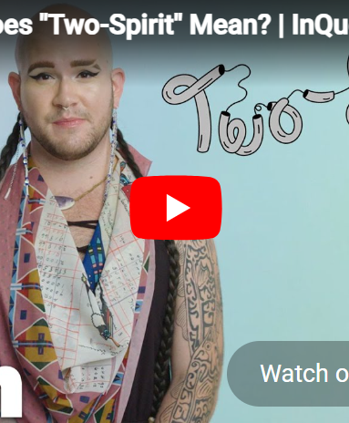
Grades 6-8
Understanding Two-Spirit and Indigiqueer Identities
Explore: https://libguides.okanagan.bc.ca/IndigenousStudies/two-spirit-and-indigiqueer
Choose:
Reflection (Writing)
  What did you learn about Two-Spirit and Indigiqueer identities?
  Why does this learning matter?
Visual Representation
  Create a visual that shows your understanding of identity: symbols, words, and images. Show how identity can be complex and personal

Slide 29
05
Secondary

Slide 30

Grades 9-12
Meet Mount Boucherie Alumni, Feather Mason.
Discuss: What feelings does Feather’s poem elicit for you? What do we know about MMIWG2S+ in Canada? What questions does Feather’s poem bring up for you? What do you want to learn more about?

Slide 31

Grade 9-12
Moosehide Campaign
https://education.moosehidecampaign.ca/lateryears/
View and download the lesson plans for secondary students. These lesson plans are designed for students from 9-12.

Slide 32
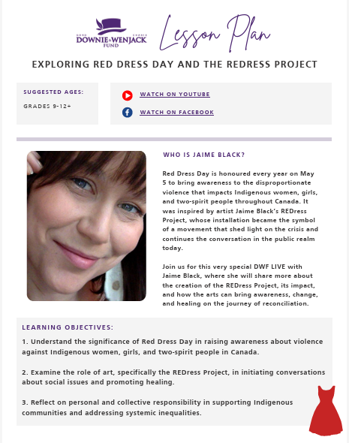
Grades 9-12
Exploring Red Dress Day and the REDress Project
Lesson Plan - Red Dress Day

Slide 33
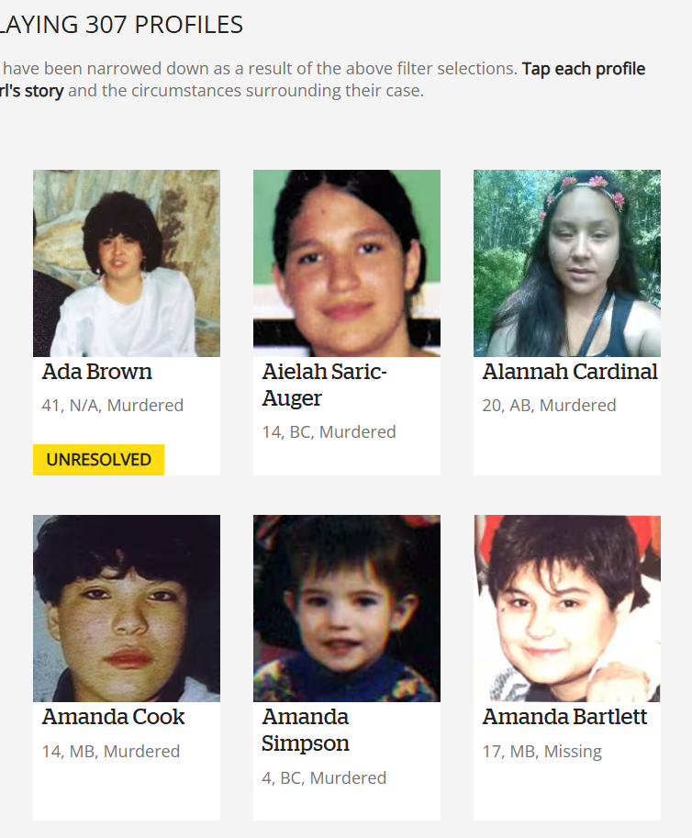
Grades 9-12
Explore https://www.cbc.ca/missingandmurdered/
Move between statistics and individual stories. What does each reveal? What gets lost?
Respond: Why do we need both data and stories to fully understand this issue?

Slide 34
06
Additional Considerations

Slide 35
Additional Considerations
Creating a Safe and Respectful Learning Environment
Let students know ahead of time that the topic may be emotional or heavy
Offer choice in how students engage, listen, reflect, step out
Avoid putting Indigenous students in positions where they feel they need to speak or represent
Build in quiet processing time, not just discussion
Have support options visible and normalized (not just “in case”)
Grounding the Learning
Center Indigenous voices, stories, and leadership, avoid speaking about without including
Use current, accurate language, including MMIWG2S+
Emphasize that this is a present-day issue, not only historical
Connect learning to local context and community when possible
Here are some powerful suggestions from Samantha Beynon for exploring Indigenous resources within your classrooms

Slide 36
Additional Considerations
Supporting Emotional Responses
Expect a range of reactions, sadness, anger, confusion, silence
Validate emotions without trying to fix or minimize
Offer simple grounding strategies (pause, breathe, step out, write)
Follow up with students who may need additional support
Being Intentional with Content
Avoid graphic or sensationalized details
Focus on dignity, humanity, and impact, not just trauma
Balance truth-telling with stories of strength, resilience, and advocacy
Be mindful of age and developmental appropriateness

Slide 37
Additional Considerations
Facilitating Meaningful Dialogue
Use open-ended questions that invite thinking, not “right answers”
Encourage listening to understand, not to respond
Model how to hold complexity and uncertainty
Interrupt harmful or dismissive comments with care and clarity
Connecting to Action and Agency
Help students see that learning can lead to action
Offer options for response, reflection, advocacy, creative expression
Avoid guilt-based framing, focus on responsibility and awareness
Highlight ways individuals and communities are making change

Slide 38
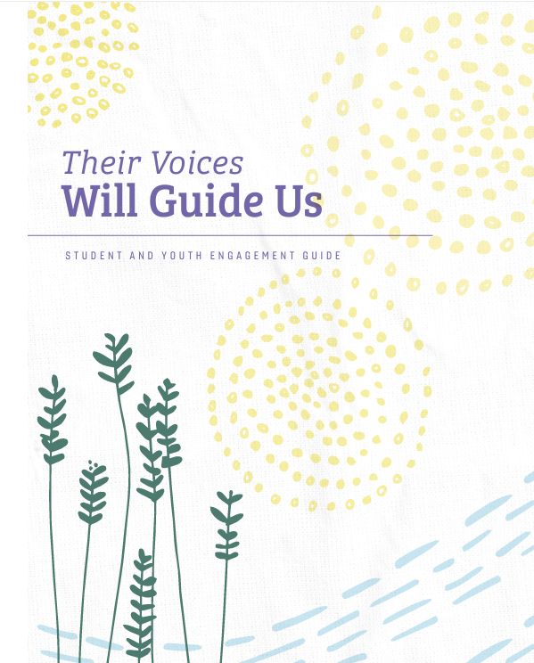
Additional Resources
The Student and Youth Engagement Guide provides essential information and considerations for educators and learners (target audience is grades 4 and up for this resource).

Slide 39
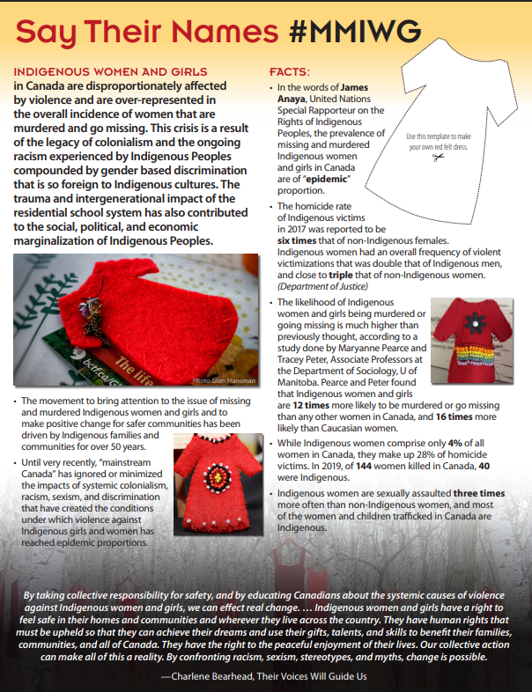
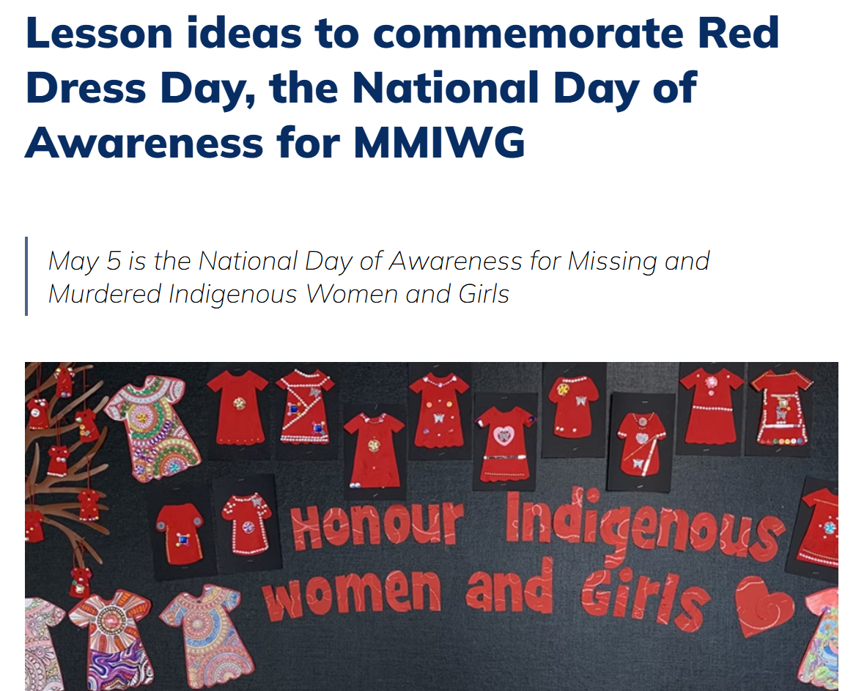
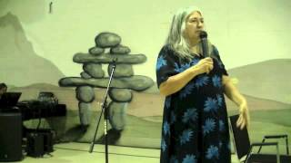
Additional Resources
Lesson ideas to commemorate Red Dress Day, the National Day of Awareness for MMIWG
Video: Lee Maracle: Connection between Violence against the Earth and Violence against Women
Say Their Names #MMIWG

