Slide 1

Suzanne Perreault
Counsellor & Inclusive Ed Consultant/Presenter

Slide 2
IEP’s & Language
Suzanne Perreault
Notes:
Personal story
why you are here
why is this my passion

Slide 3
Where do we begin?
Asking yourself these questions…
Suzanne Perreault
Notes:
Discerning where to start is key to advocating for our children
What is advocacy? Advocacy is standing and/or speaking on one's behalf or a group
Advocacy helps us stay away from learned helplessness

Slide 4
IEP’s have 7 Stages – A Planning Cycle –
Assessment
Collaboration
Writing
Introduction
Reporting
Reviewing
Monitoring
It should guide the implantation of the learning plan
Suzanne Perreault

Slide 5
Do you know the Language?
Adaptation
Modifications
Assessment
Collaborative Consultation
Integration
Advocacy
Suzanne Perreault
Notes:
NB of understanding language so you know what you are advocating for
Adaptions: are teaching and assessment strategies especially designed to accommodate a student’s needs so he or she can achieve the learning outcomes of the subject or course and to demonstrate mastery of concepts. Essentially, adaptations are “best practice” in teaching.
Modifications: are instructional and assessment-related decisions made to accommodate a student’s educational needs that consist of individualized learning goals and outcomes which are different than learning outcomes of a course or subject. Modifications should be considered for those students whose special needs are such that they are unable to access the curriculum
. Assessment: process of gathering information in order to make appropriate educational decisions for a student. It is a collaborative and progressive process designed to identify the student's strengths and needs, set goals, and results in the identification and implementation of identified educational strategies.
Collaborative consultation: people work together to solve a common problem or address a common concern. A successful collaborative process is characterized by the following features: it is voluntary; there is mutual trust and open communication among the people involved
Integration: the major strategies used to achieve inclusion providing accommodations…see: SPECIAL EDUCATION SERVICES: A MANUAL OF POLICIES, PROCEDURES AND GUIDELINES https://www2.gov.bc.ca/assets/gov/education/administration/kindergarten-to-grade-12/inclusive/special_ed_policy_manual.pdf
Advocacy: Advocacy is standing and/or speaking on one's behalf or a group

Slide 6
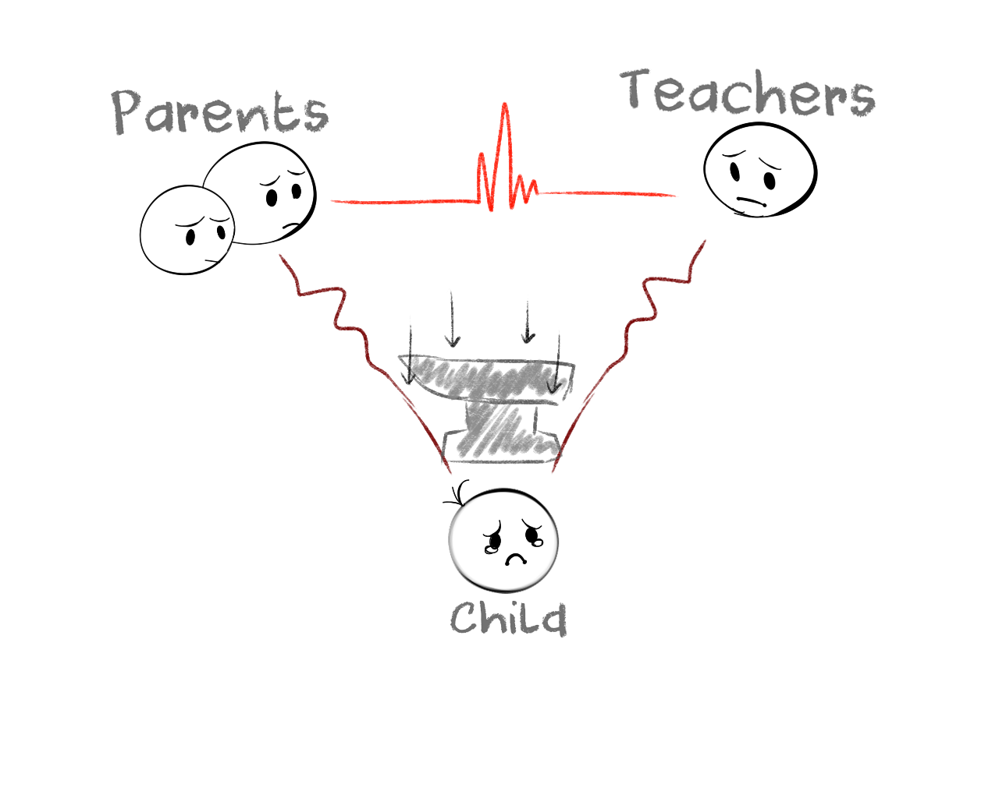
What we need to do to ready ourselves
Suzanne Perreault
Notes:
Self-Care: recoginize triggers, eat well, sleep well,
Gather team if necessary: SLP, OT, BC/BI, RDI Consultant, ABA Consultant, etc
Create notes, questions to ask, assemble history and identified goals

Slide 7
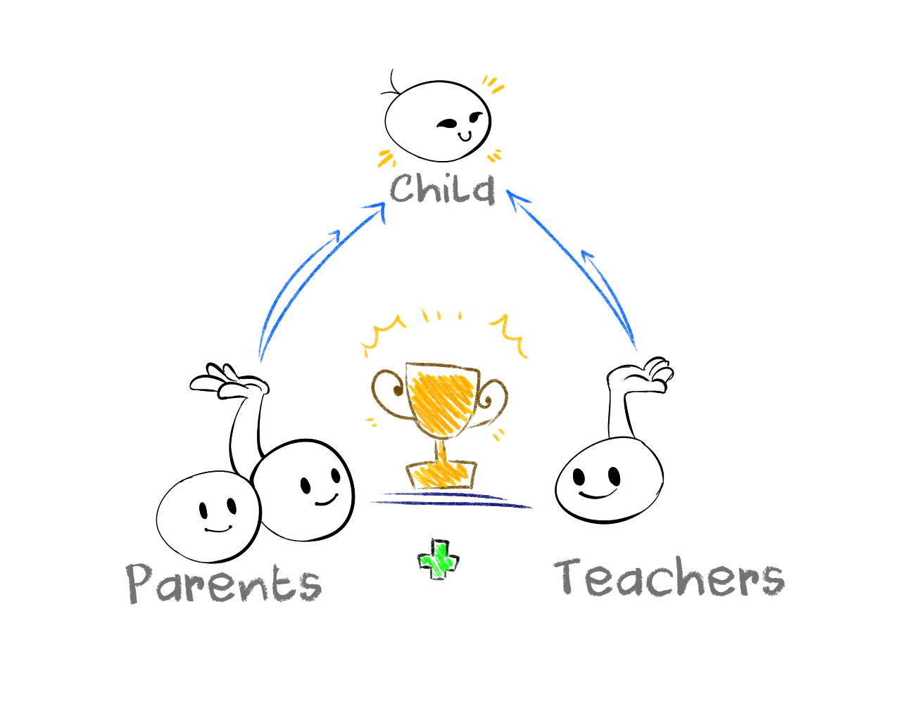
Experiences of Success
Suzanne Perreault
Notes:
When, even at the basic level, effective collaboration and communication through advocacy has occurred the parent/teacher relationship moves to a place where the child is supported and therefore their emotional well being is supporting giving pathways to success in other called upon outcomes.

Slide 8
Where do we go from here?
Personal Supports
Setting up Goals
Planning & Preparing
Self Care
Lines of Communication
Keeping a record
Suzanne Perreault
Notes:
Where do we go from here?: There is a process and it starts with us – do we understand what we need and how it leads to the “end goal” (success for our children)?
Personal Supports: Do you have them set up; are they aligned with the challenges at hand
Setting up Goals: this are goals for your child, achievable goals
Planning & Preparing: talk to the school, prepare them, speak to it, put it in writing (copies of reports from doctors, pediatrician, speech therapy, OT, etc.)
• review & understand the "Hewko/Moore" court decision (2006 Hewko vs Abbotsford School District) • "Instructional control" must be clear & present
Self Care: Fight-flight-freeze; rest; eating; self-reg
Lines of Communication: Teacher, Resource, Administrator, Director of Learning Support; Assist. Superintendent, Board…media?
Keeping a record: The Binder

Slide 9
The Binder
Communication:
School contact list
Communication log
Letters and emails to and from the school
Evaluations:
Request/referral for evaluation
Consent to evaluate (keep copy if possible)
Private evaluations (if your child has had any)
IEP:
Copies
Manual of Policies, Procedures and Guidelines:
  https://www2.gov.bc.ca/assets/gov/education/administration/kindergarten-to-grade-12/inclusive/special_ed_policy_manual.pdf
Report Cards/Progress Notes:
Behavour:
Reports
Communication
Suzanne Perreault

Slide 10
Inclusion is not a program but a mindset of social integration and how we treat others.
Language and Empathy Matter
Suzanne Perreault

Slide 11
Suzanne Perreault
Counsellor & Inclusive Ed Consultant/Presenter
suzannemp.cca@gmail.com
See me on TEDx
Suzanne Perreault, TEDx Langley
Supporting Educators & Families who journey in life with neurodiversities, anxiety & PTSD

